Slide 1

LAB – 5 CYCLIC REDUNDANCY CODING:
Goals: To understand how CRC hardware generates CRC check bits.

Slide 2
COMPONENTS:
VCC
74LS86 Quad Two-Input Exclusive OR (3)
74LS74 Dual D Flip-Flop (5)
Probe (5)
SPDT (2)
Ground (2)

Slide 3
Cyclic Redundancy Coding:
Cyclic redundancy check (CRC) is a common data transmission error detection technique commonly used in the digital data communication field.
The transmit end calculates a check code for the data in a data frame based on a certain algorithm, appends the check code to the data frame, and sends the data frame to the receive end.
CRC is based on binary division and is also called “polynomial code checksum.”
1010001101 --- 01110

Slide 4
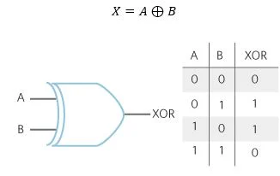
Exclusive OR (Truth Table)

Slide 5
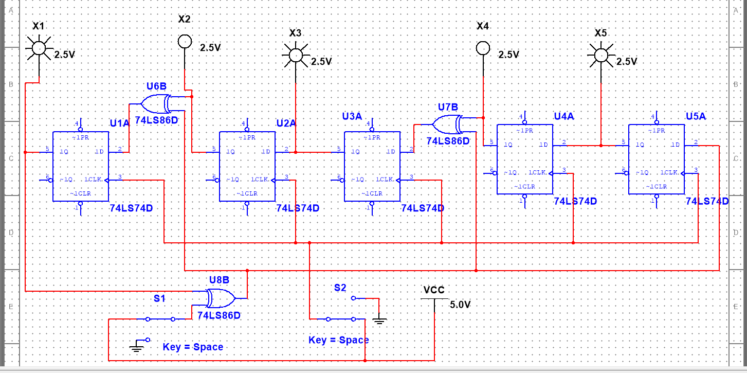
Circuit Diagram :

